Slide 1

Cornish Tin Mining
Notes:
Tin mines were once the most important mines in Cornwall, but tin mining disappeared in the 1990’s.

Slide 2
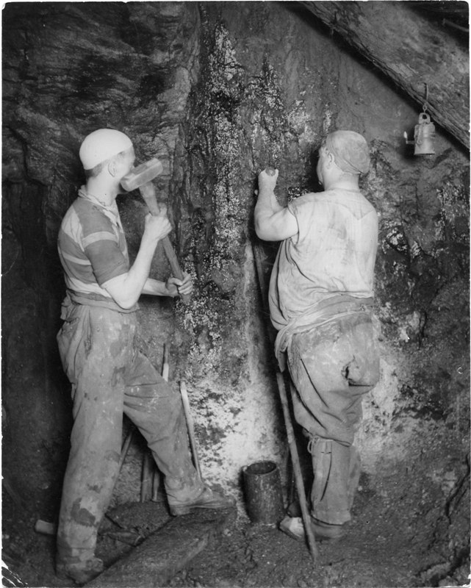
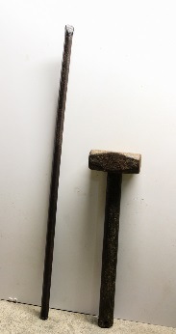
To extract the tin, the hard rock had to be broken.
These miners are using a hammer and gad to drill a hole.
Notes:
Before explosives were introduced, the breaking of the rock was done by hand using hammers, chisels, rock wedges, and poll picks. It was laborious and time-consuming.

Slide 3
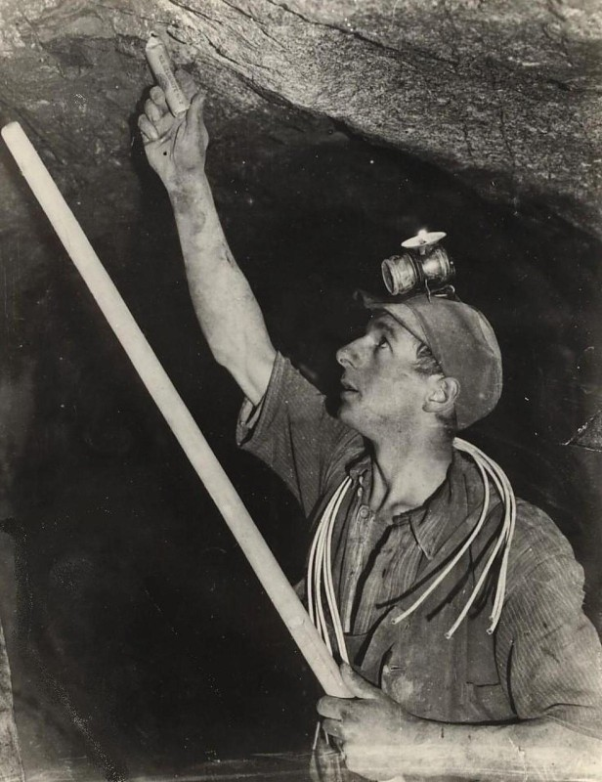
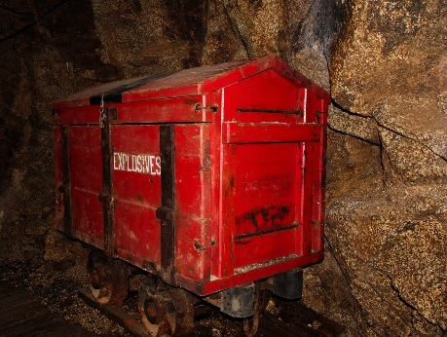
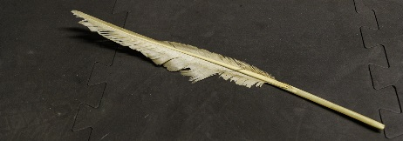
Blasting with gunpowder enabled more rock to be broken, but it was also dangerous.
A goose quill which would have been used to create a fuse
Notes:
Many miners were injured or killed when charges went off early, or when they returned to re-light fuses, which were often unreliable and made from goose quills. In the modern mine, rock was blasted using gelignite, a much more powerful explosive.

Slide 4
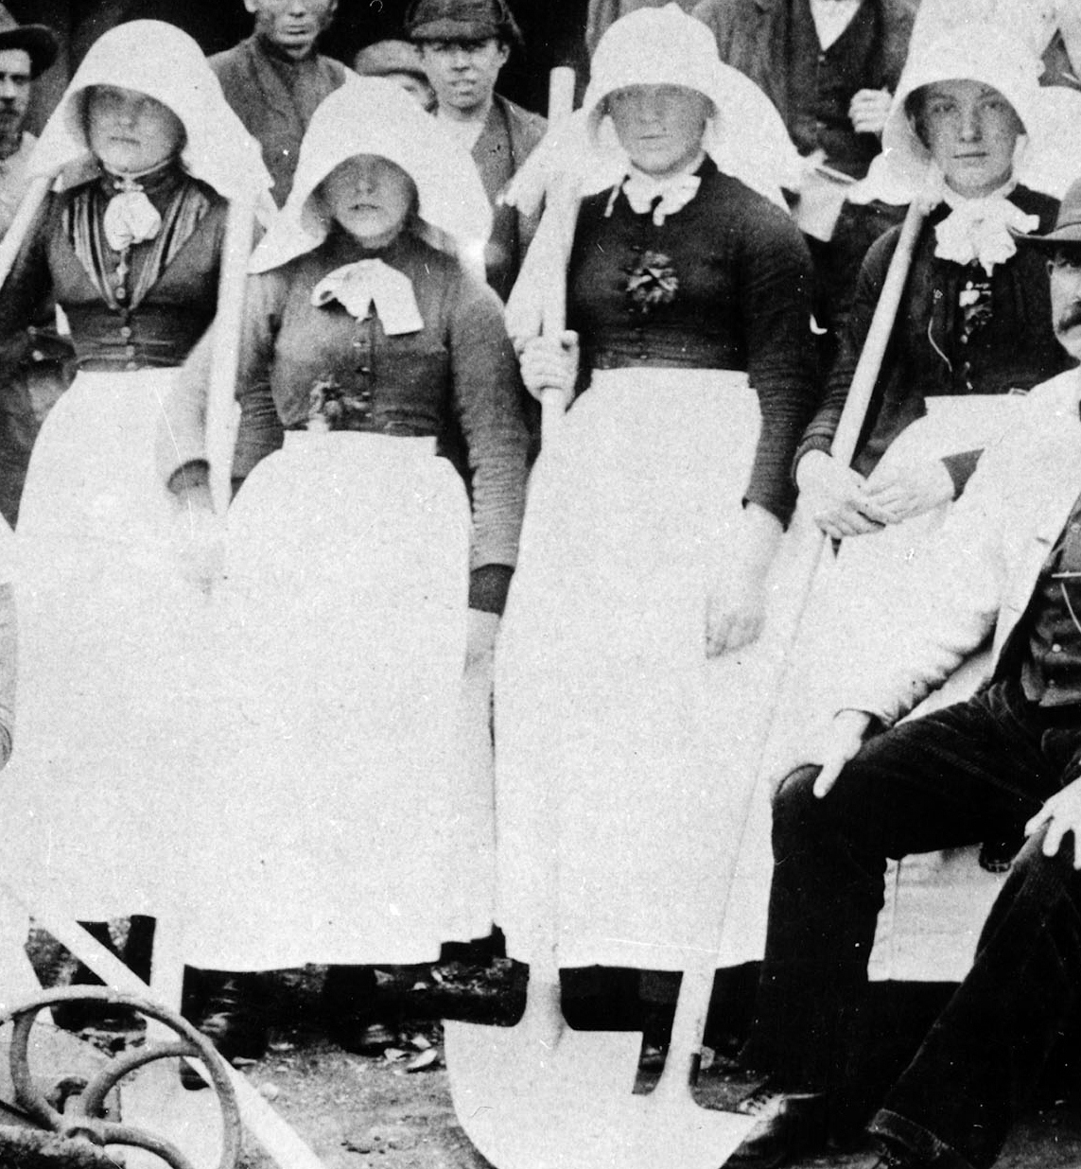
On the surface, women called Bal Maidens broke the rock into small pieces
Notice the hats worn by the women, these provided the eyes some protection from flying chips of rock.
Spades like this are still known as “Cornish Shovels”
.
Notes:
Women and girls worked outside the mine on the dressing floor. It was considered unlucky for women to work underground.

Slide 5
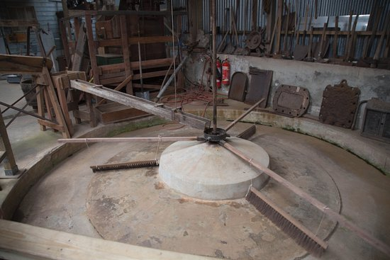
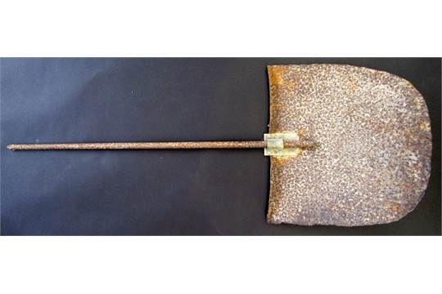
The tin ore then had to be separated from the granite.
Buddles like this one at King Edward Mine helped the process which could also be done by hand with a vanning shovel.
Notes:
The vanning shovel was used like a “gold panning” pan using water to float away the lighter rock leaving the heavier tin behind. The buddle did it on a larger scale!

Slide 6
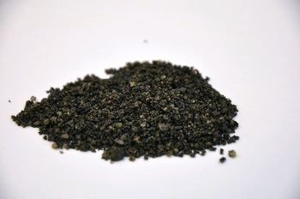
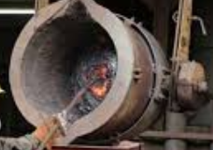
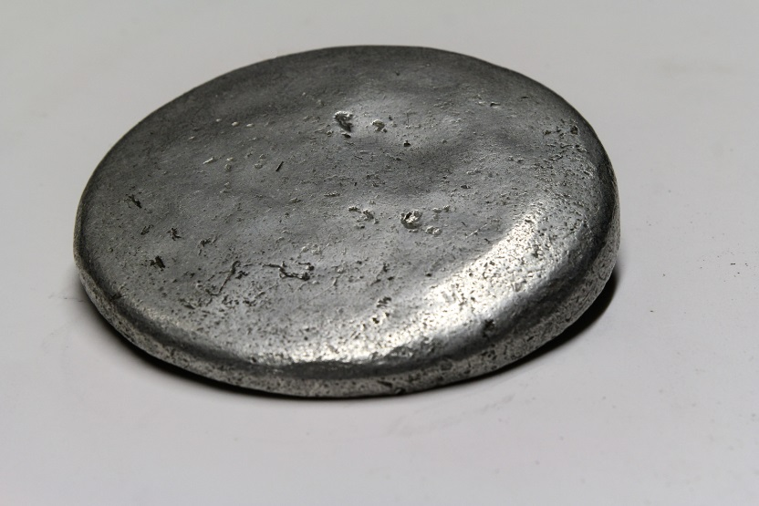
The resulting tin concentrate could then be smelted into solid tin.

